Slide 1
WAVE-PARTICLE DUALITY
&
QUANTUM THEORY
Because the alternative is spending the next few weeks banging our heads against the desks…

Slide 2


Slide 3
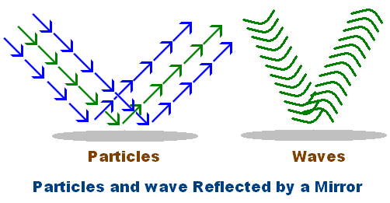
WAVE MODEL VS PARTICLE MODEL
So, is light a particle or a wave?
Sir Isaac Newton explained light in terms of particles that he called corpuscles, with each different colour of the spectrum representing a different type of particle.
Christian Huygens proposed a model of light as a wave.
Both models could adequately describe certain observable phenomena, such as reflection:

Slide 4
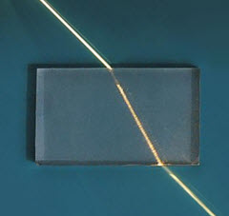
WAVE MODEL VS PARTICLE MODEL
However, neither model was quite perfect. For example, Newton’s Corpuscular Theory predicted that light would speed up when travelling through a solid material (i.e. glass), whereas the Wave Theory predicted that light would, in fact, slow down.
Although the technology did not exist at the time for either scientist to test their rival claims, we now know that light does, in fact, slow down as it enters any medium that is more optically dense than a vacuum, resulting in refraction.
Notes:
*We don’t cover Snell’s Law, Law of Reflection etc., as these have been covered in Yr 9, Yr 11, and are not part of the Yr 12 Course.

Slide 5
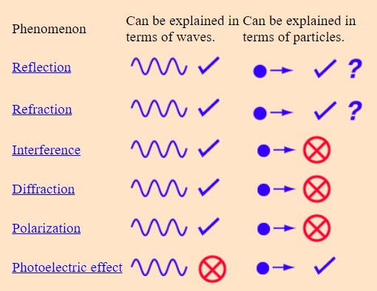
WAVE MODEL VS PARTICLE MODEL
Nonetheless, each theory has supporting evidence… along with phenomena that they cannot explain (which we shall cover in due course):
Notes:
Wave-Particle Duality (gsu.edu)

Slide 6
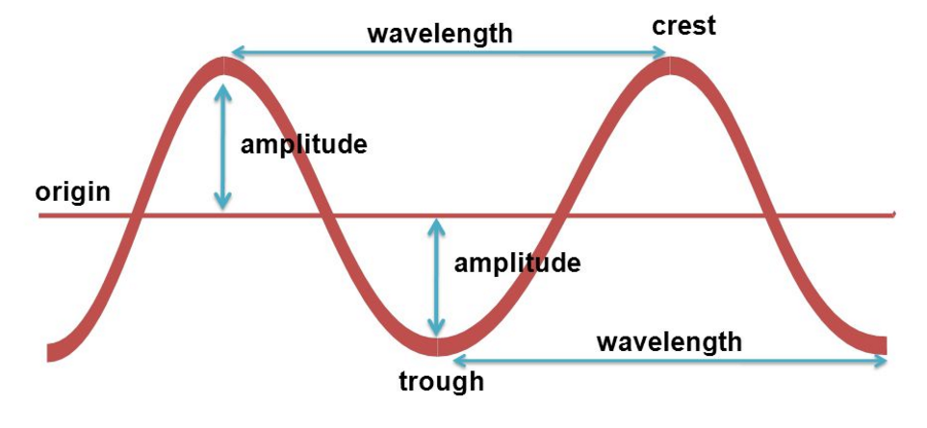
MODEL OF A WAVE
Before we get too carried away, let’s recap some wave-terminology that should hopefully be familiar:
Period (Τ) = Time for the wavefront to travel a distance of λ.
Frequency (f) = 1/Τ = the number of waves to pass a point in 1 second (Hz).
Amplitude is a measure of the energy carried by the wave.
(λ)

Slide 7
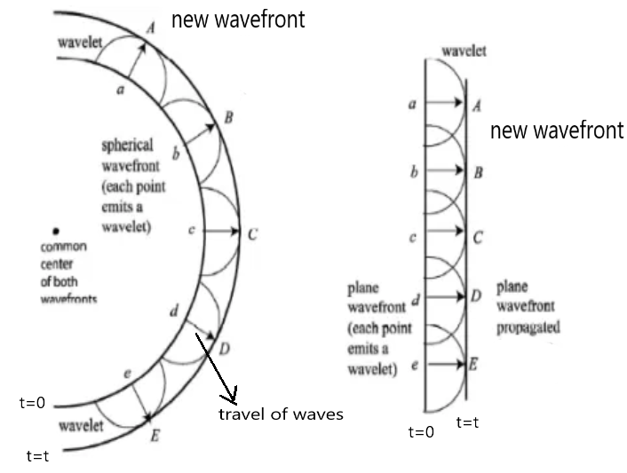
HUYGENS’ PRINCIPLE
Notes:
Treat each wavefront as a new point-source. When resolving the new wavefronts, the pattern is found to continue. This model is useful, but has certain flaws, most of which are beyond the scope of the course (the one that isn’t is the fact that it cannot explain the Photoelectric Effect).

Slide 8
DISPERSION
White light is comprised of the colours of the rainbow. When white light passes from a vacuum to glass, the light waves slow down. Frequency remains unchanged, so according to the Wave Equation, wavelength must decrease.
v = f λ
The wavelengths of the different colours are compressed by slightly different amounts, so each colour travels at a slightly different speed, and is therefore refracted by a slightly different amount. Consequently, the colours of white slight can be separated out. This is dispersion.

Slide 9
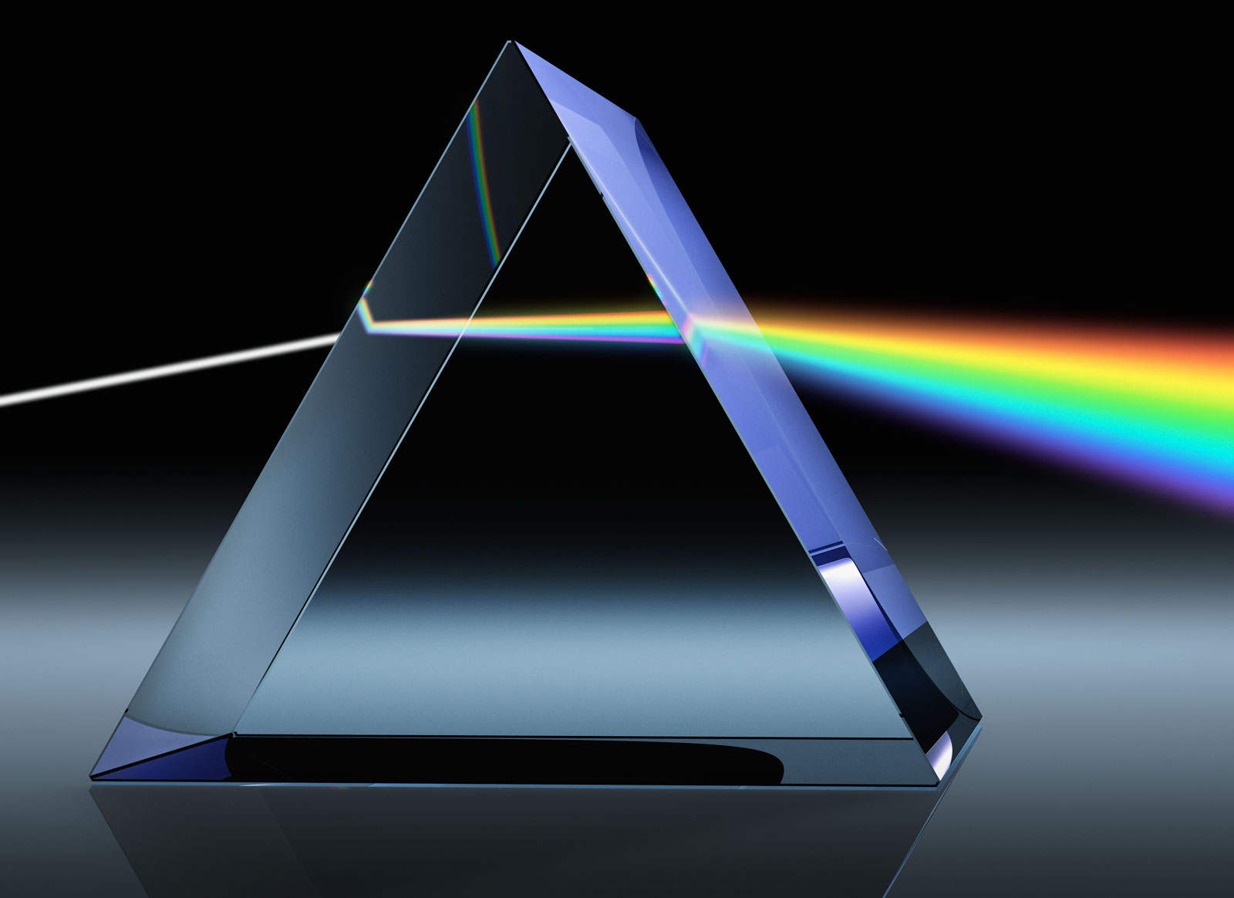
DISPERSION
Longer wavelengths (red) travel faster in the new medium and so are refracted least. Shorter wavelengths (violet) travel slower in the new medium and are refracted more.

Slide 10
DISPERSION
This was how Sir Isaac Newton was able to demonstrate that white light was comprised of multiple colours. The colours are (as every child knows): Red, Orange, Yellow, Green, Blue, Violet (ROYGBV).
Newton was a bit of a superstitious man (as were many in his time), and believed that the number 7 was somehow sacred or mystical. For this reason, he slipped another colour into the rainbow that isn’t really there… Indigo.
This just goes to show that nobody’s perfect. That said, this is the guy who first described gravity and, in so doing, basically invented calculus. Still, the mistake persists in some Physics texts even today.

Slide 11
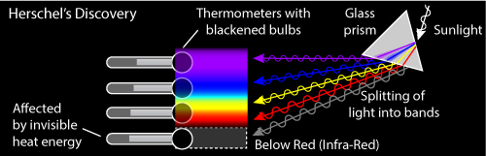
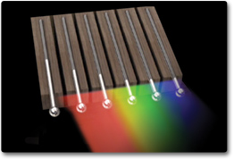
DISPERSION
Dispersion actually led to the realisation that the electromagnetic spectrum consisted of more than just the visible spectrum (William Herschel, circa 1800). Herschel was trying to establish which colour of light carried the most energy…
This thermometer, meant as a control, turned out hotter than the thermometers exposed to visible light; it was measuring infrared!

Slide 12
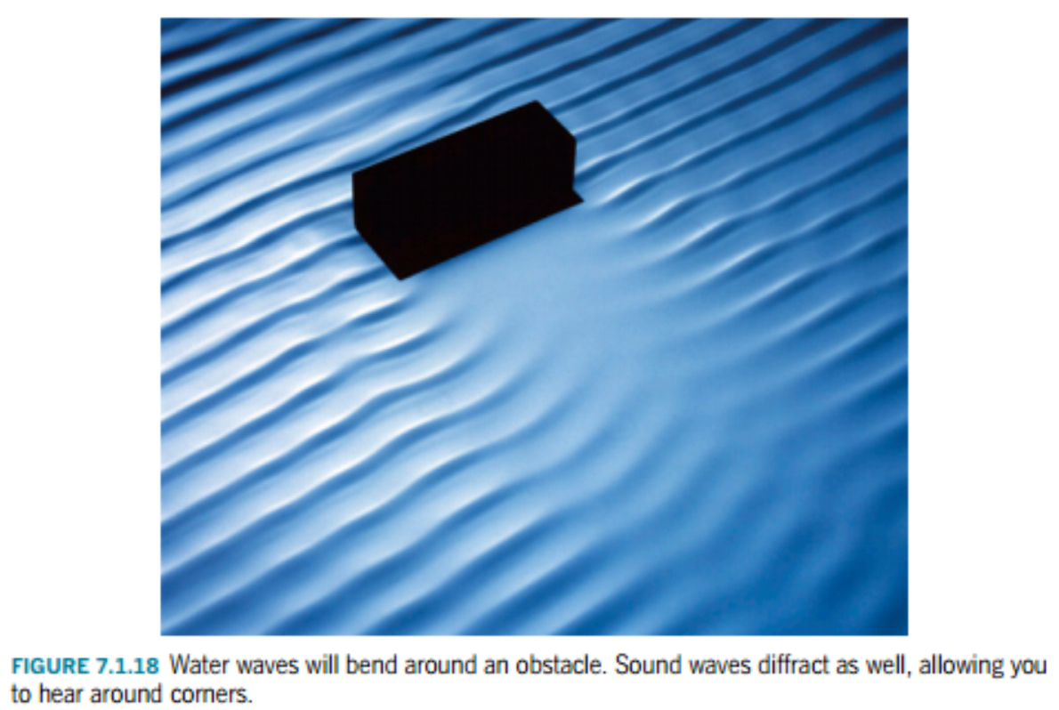
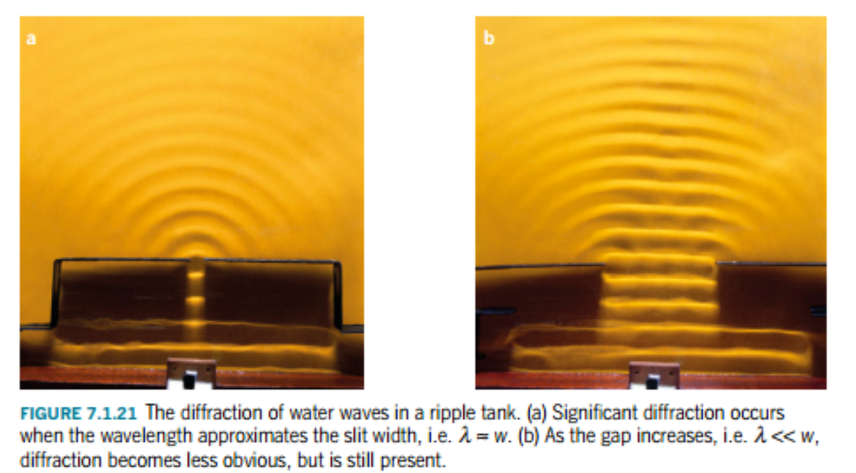
DIFFRACTION
When a wave passes through a narrow opening, it bends. This bending is significant when the size of the opening/obstacle/aperture is similar in size to the wavelength (or smaller).
*Similar in size = typically within an order of magnitude (x10).

Slide 13
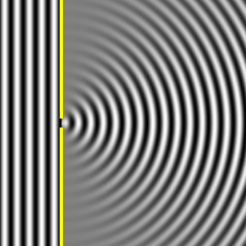
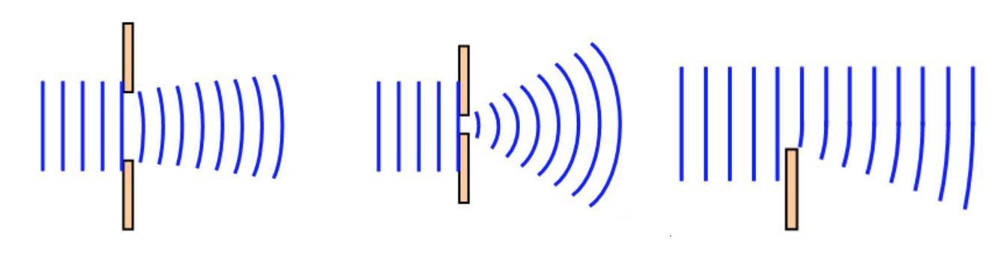
DIFFRACTION
Diffraction is useful for explaining why sound can travel around corners (but not light – why not?).
Notes:
Ans: compare wavelength to size of aperture – no significant diffraction.

Slide 14
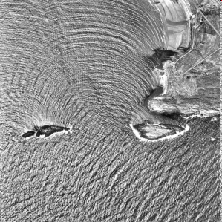
DIFFRACTION (IN THE SEA)

Slide 15
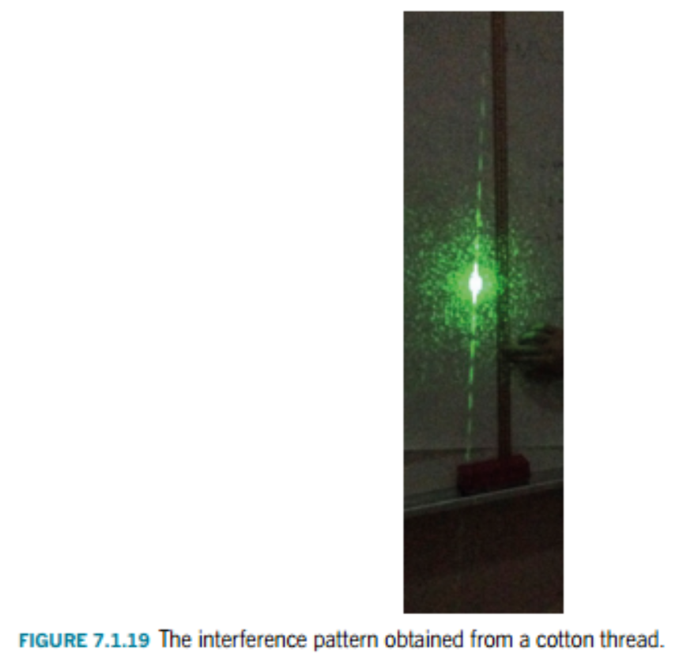
DIFFRACTION
Diffraction patterns: the wavefronts passing through the gap interfere with themselves, creating patterns of constructive and destructive interference (more on this later).
Notes:
Feynman himself said that there is no real distinction between diffraction and interference, save the starting point.

Slide 16
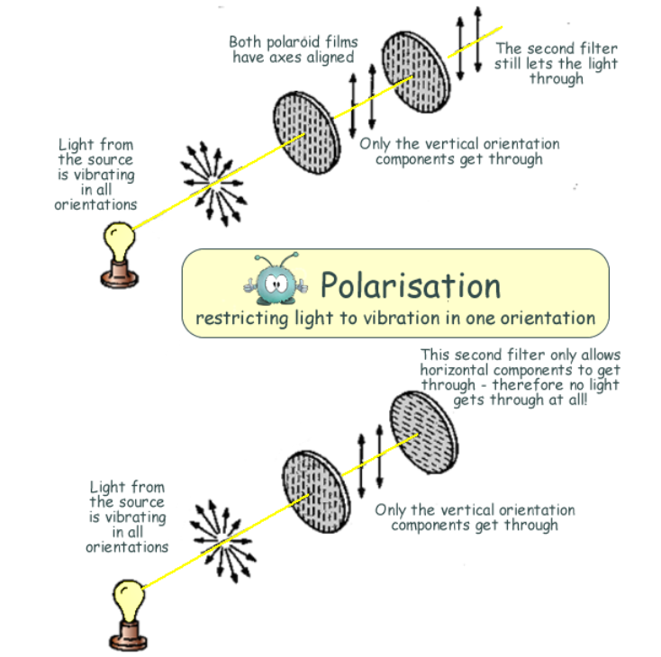
POLARISATION
Polarisation is one of the most convincing pieces of evidence for the wave theory of light.
Polaroid filters only allow light to pass through in certain orientations. The result is that unpolarised light turns into polarised light.
A wave can only pass through a filter if it has the correct orientation (or if a vector-component of the wave is in the correct orientation).

Slide 17
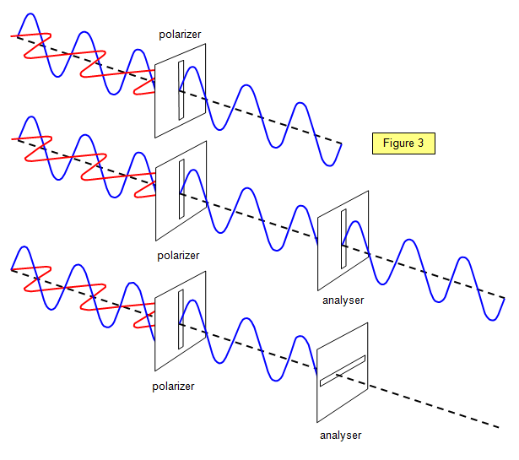
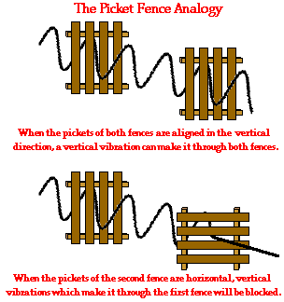
POLARISATION

Slide 18
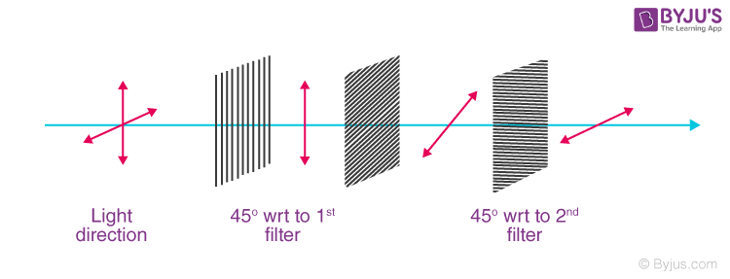
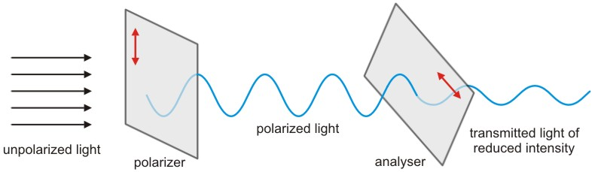
POLARISATION

Slide 19
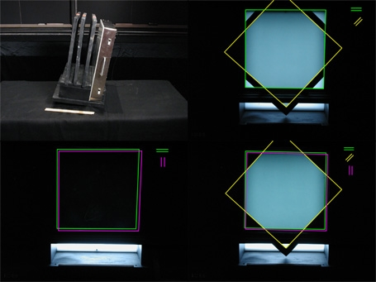
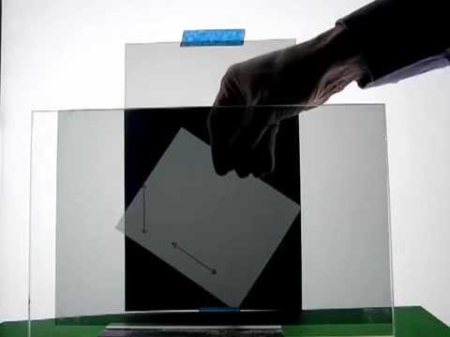
POLARISATION

Slide 20
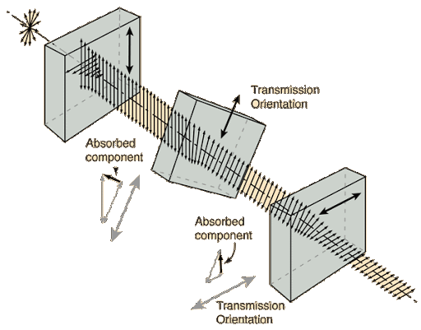
POLARISATION

Slide 21
YOUNG’S DOUBLE-SLIT EXPERIMENT
In 1801, Thomas Young devised a brilliant experiment to test the nature of light; the double-slit experiment. The experiment was predicted to have one of two different outcomes, dependant upon either a particle-model or a wave-model for light.
A single, monochromatic (single-frequency) light-source is shone through an opaque partition with two uniform slits cut into it, and onto a screen.
The particle-model predicts two big ‘patches’ of light on the screen, one in front of each slit.
The wave-model predicts an alternating pattern of light and dark patches or lines; an interference pattern.

Slide 22
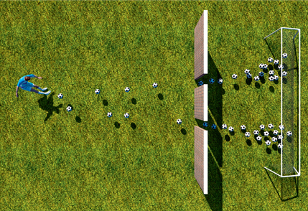
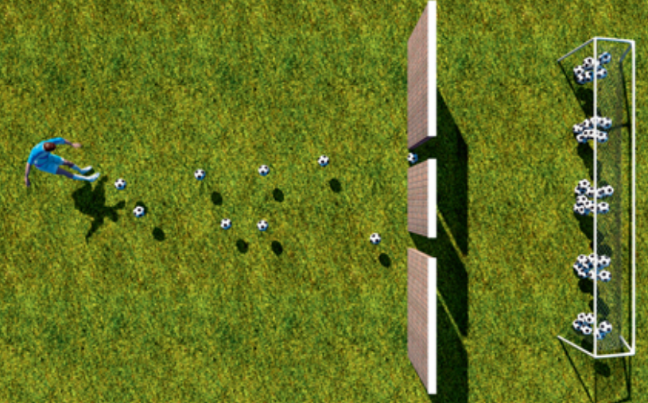
YOUNG’S DOUBLE-SLIT EXPERIMENT
Particle-Model Prediction Wave-Model Prediction

Slide 23
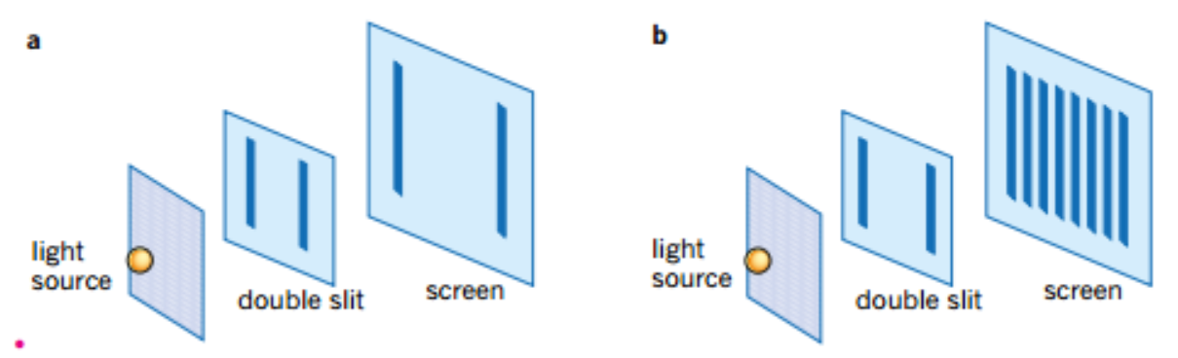
YOUNG’S DOUBLE-SLIT EXPERIMENT
Particle-Model Prediction Wave-Model Prediction

Slide 24
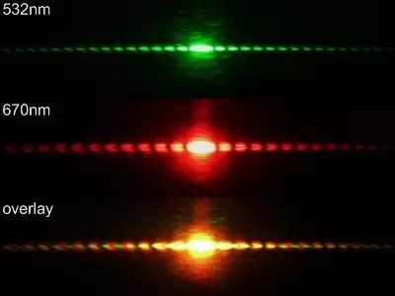
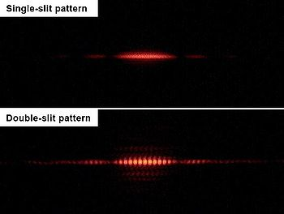
YOUNG’S DOUBLE-SLIT EXPERIMENT
So, which did he observe?
Wave-Model solution!

Slide 25
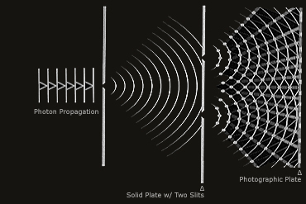
YOUNG’S DOUBLE-SLIT EXPERIMENT
Why does this occur?
Diffracted wavefronts from each slit overlap at various points in space; at some points they reinforce each other (constructive interference), whereas at other points they cancel each other out (destructive interference).
This is called superposition.

Slide 26
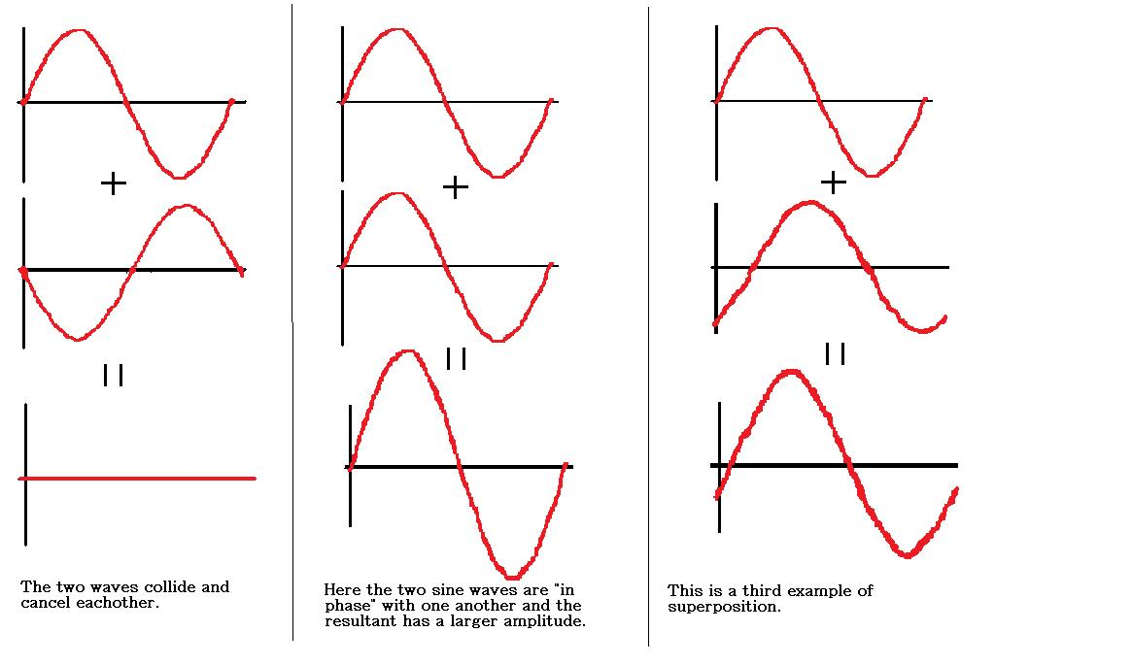
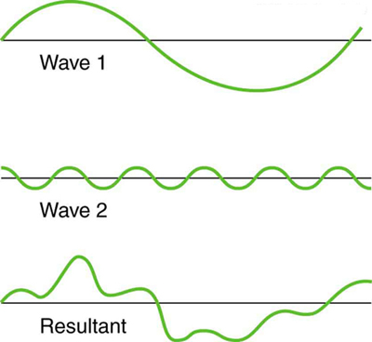
SUPERPOSITION
Destructive Constructive
Interference Interference

Slide 27

SUPERPOSITION

Slide 28
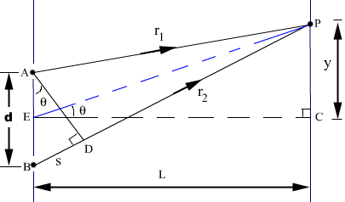
DOUBLE-SLIT EXPERIMENT
Notes:
www.citycollegiate.com

Slide 29
S = path difference = r₂ – r₁ (magnitude only).
Path difference depends on the distance between the apertures: d.
By constructing the right triangle ADB, we can derive the expression S = d sin θ, where θ is the ‘angular distance’ between point E (halfway between apertures) and point P.
Notes:
www.citycollegiate.com

Slide 30
By constructing the right triangle ADB, we can derive the expression S = d sin θ.
Constructive interference will occur if the path difference is a whole-number of wavelengths: mλ. These will be the light spots.
d sin θ = mλ , where ‘m’ is an integer
Notes:
www.citycollegiate.com

Slide 31
Destructive interference will occur if the path difference is not a whole-number of wavelengths. The point where the waves exactly cancel out will be when they are one-half wavelength apart: (m+[1/2])λ. These will be the dark spots.
d sin θ = (m+[1/2]) λ , where ‘m’ is an integer
Notes:
www.citycollegiate.com

Slide 32
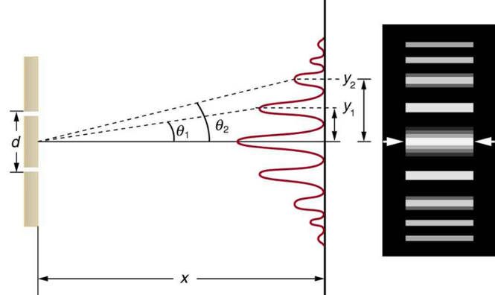
DOUBLE-SLIT EXPERIMENT
Notes:
cnx.org

Slide 33
(Destructive): d sin θ = (m+[1/2]) λ
(Constructive): d sin θ = mλ
For small angles:
sin θ ≈ tan θ = opposite = y
adjacent L
Notes:
www.citycollegiate.com

Slide 34
(Destructive): d sin θ = (m+[1/2]) λ
(Constructive): d sin θ = mλ
For small angles:
sin θ ≈ tan θ = opposite = y
adjacent L
Therefore (sub. and solve for y):
(Destructive): d y = (m+[1/2]) λ
L
(Constructive): d y= mλ
L
Notes:
www.citycollegiate.com

Slide 35
Therefore (sub. and solve for y):
(Destructive): d y = (m+[1/2]) λ
L
(Constructive): d y= mλ
L
_____________________________________________
y = L(m+[1/2]) λ (Destructive – Position of Dark Spots)
d
y = Lmλ (Constructive – Position of Light Spots)
d
Notes:
www.citycollegiate.com

Slide 36
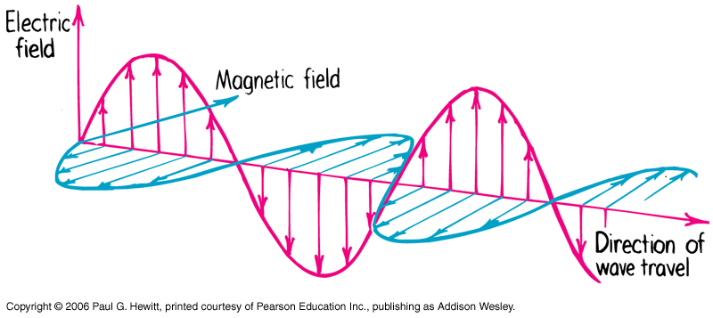
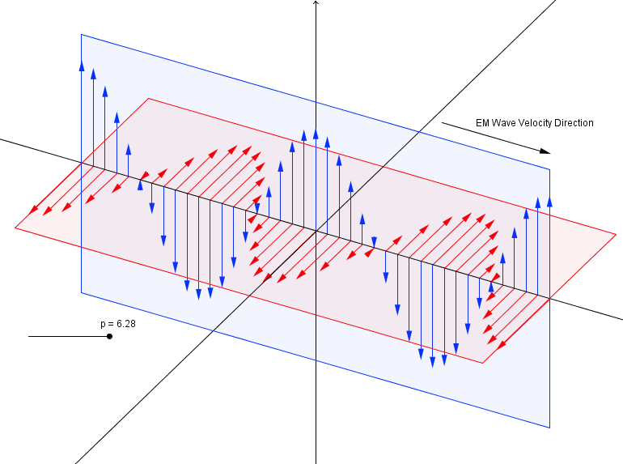
ELECTROMAGNETIC RADIATION
Electromagnetic Radiation is comprised of a series of self-propagating, alternating electric and magnetic fields. Changing electric fields induce changing magnetic fields which induce more electric fields… and so on. Each induced field is at right-angles to the field that induced it.

Slide 37
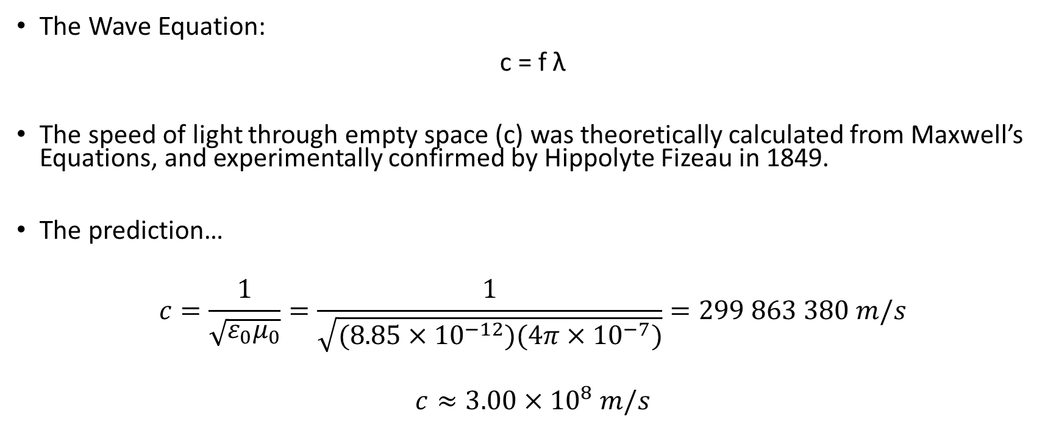
ELECTROMAGNETIC RADIATION
The Wave Equation:
c = f λ
The speed of light through empty space (c) was theoretically calculated from Maxwell’s Equations, and experimentally confirmed by Hippolyte Fizeau in 1849.
The prediction…
$$c=\frac{1}{\sqrt{ε_{0}μ_{0}}}=\frac{1}{\sqrt{(8.85×{10}^{−12})(4π×{10}^{−7})}}=299 863 380 m/s$$
$$c≈3.00×{10}^{8} m/s$$
We’ve seen these before!

Slide 38
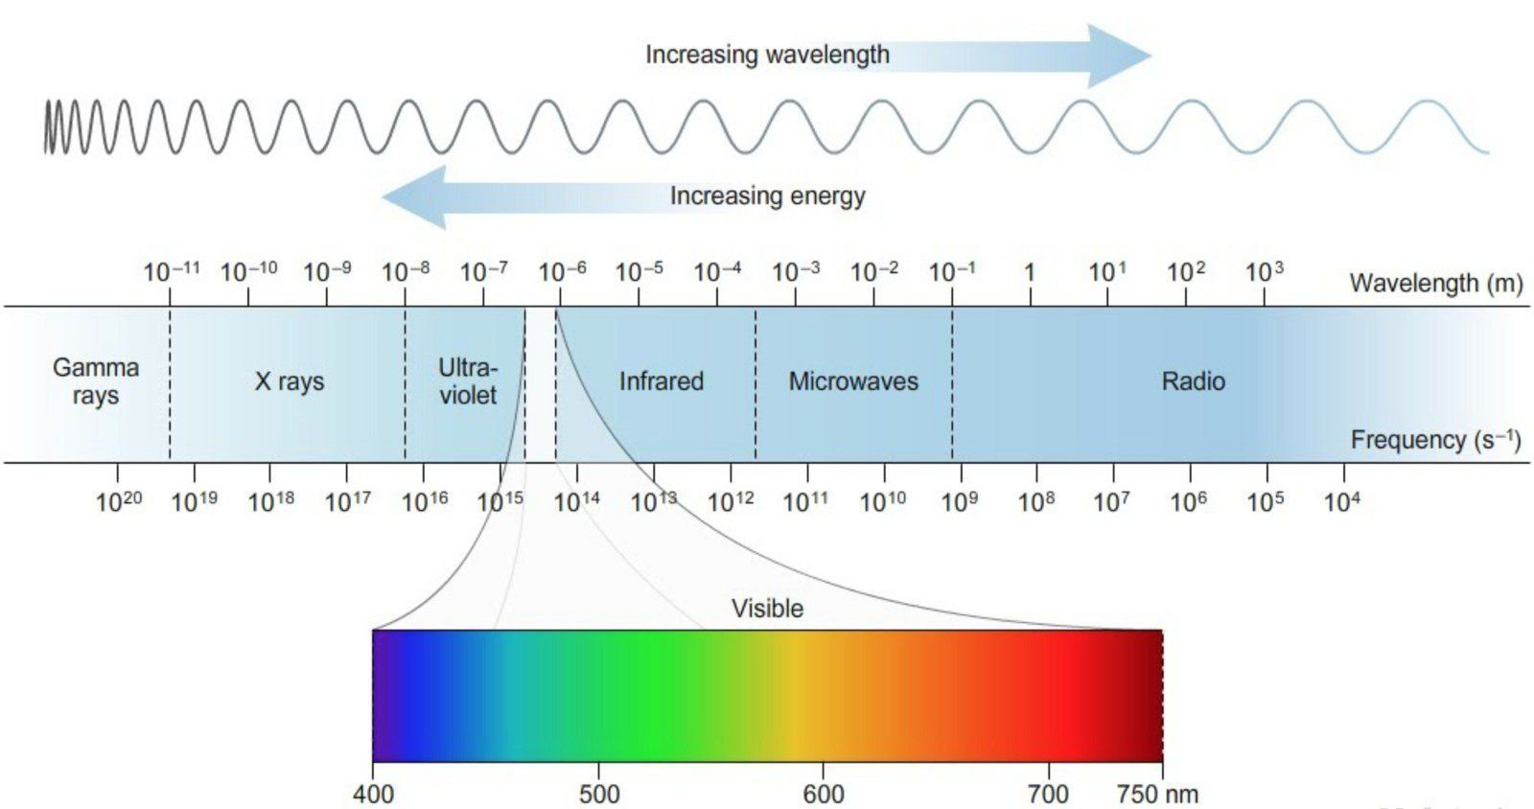
ELECTROMAGNETIC RADIATION

Slide 39
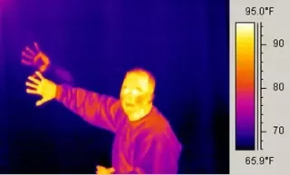
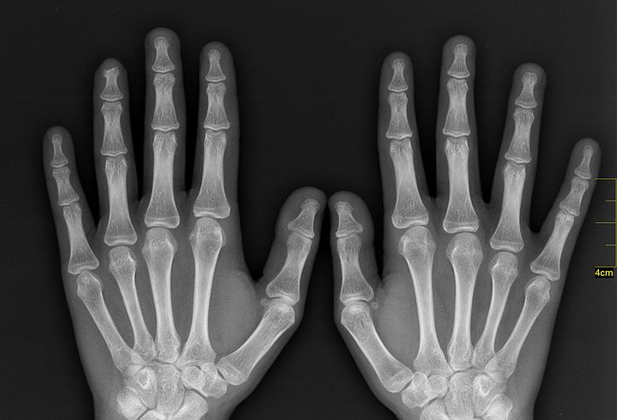
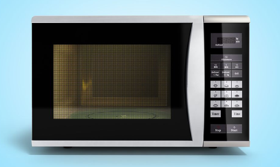
ELECTROMAGNETIC RADIATION
Why is EMR useful? Well, different frequencies have different applications (Infrared, UV, X-Ray, Microwave, Radio Wave etc.). We will look at how some of these are used.
Infrared X-Ray Microwave

Slide 40
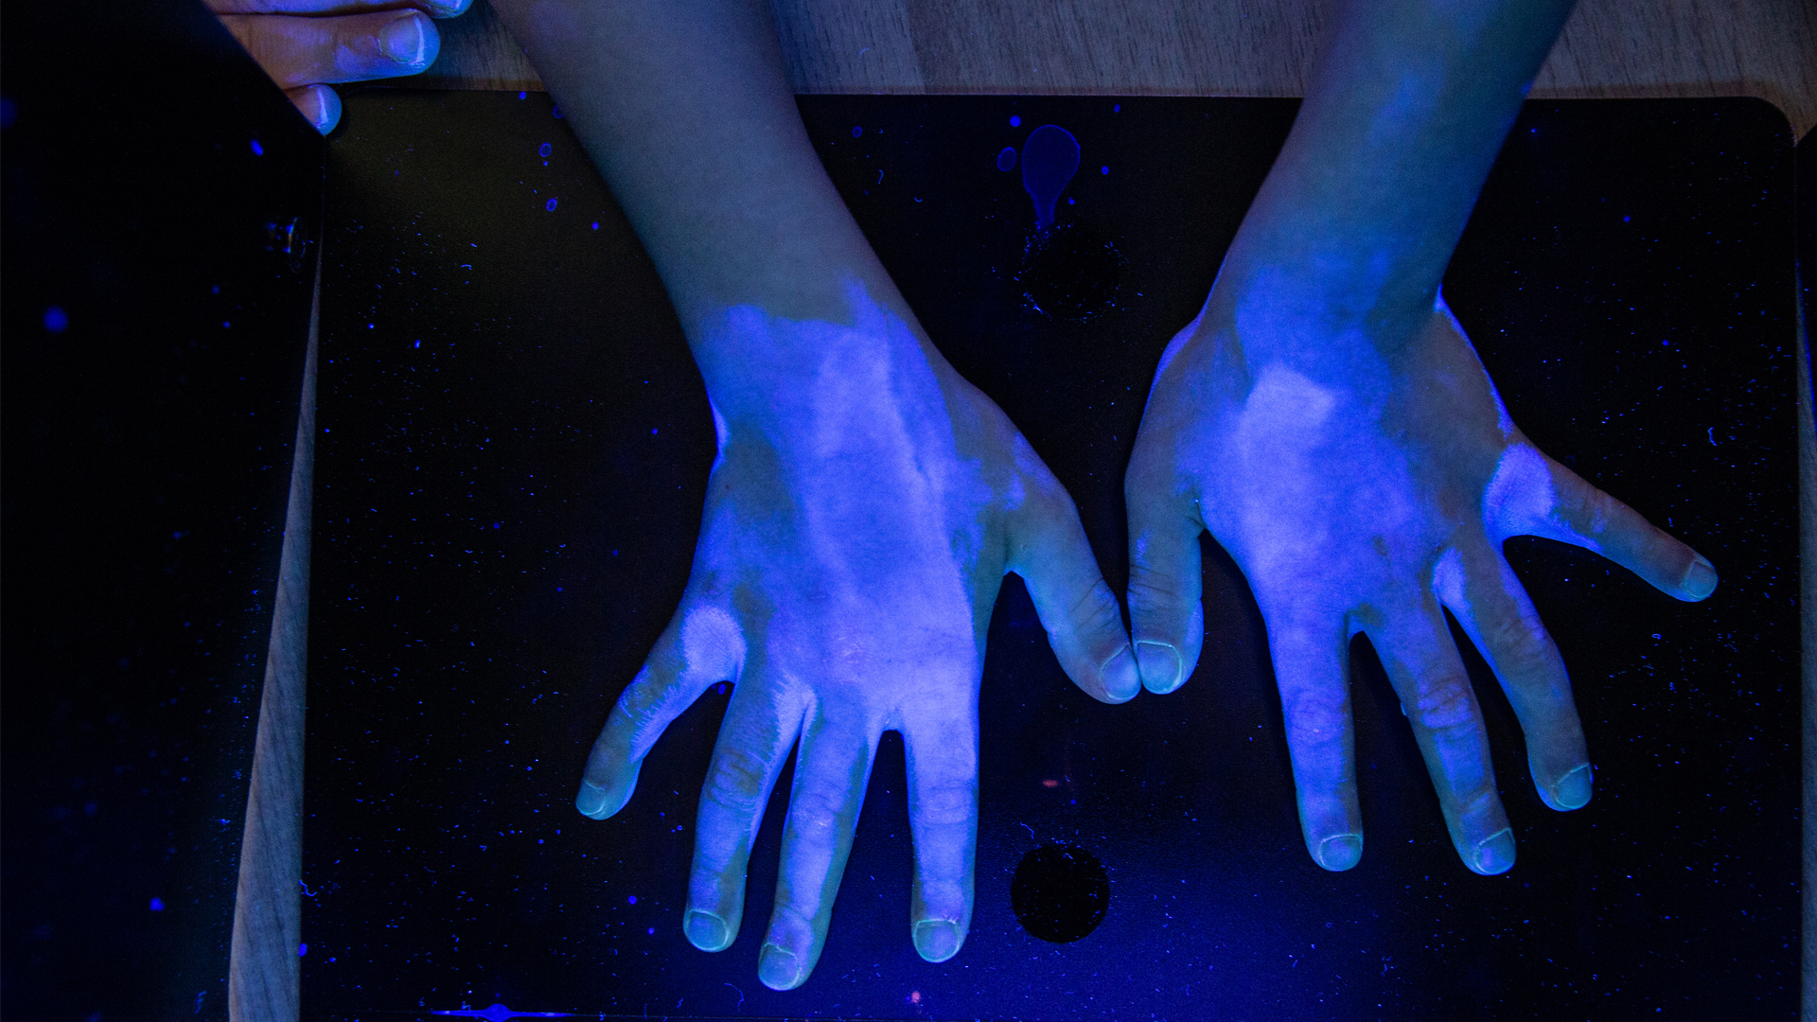

ELECTROMAGNETIC RADIATION
Ultraviolet Sunscreen (Visible & UV)
*Sunscreen can function by absorbing UV before it reaches the skin (pictured), reflecting UV, or both.

Slide 41
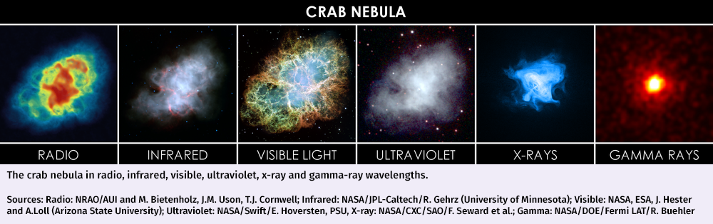
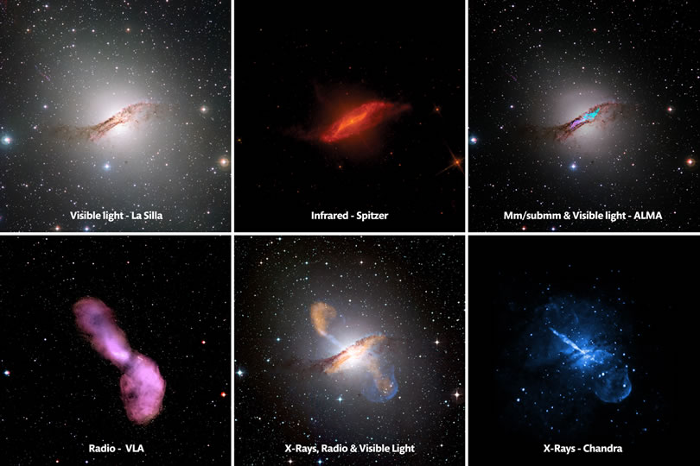
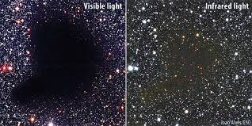
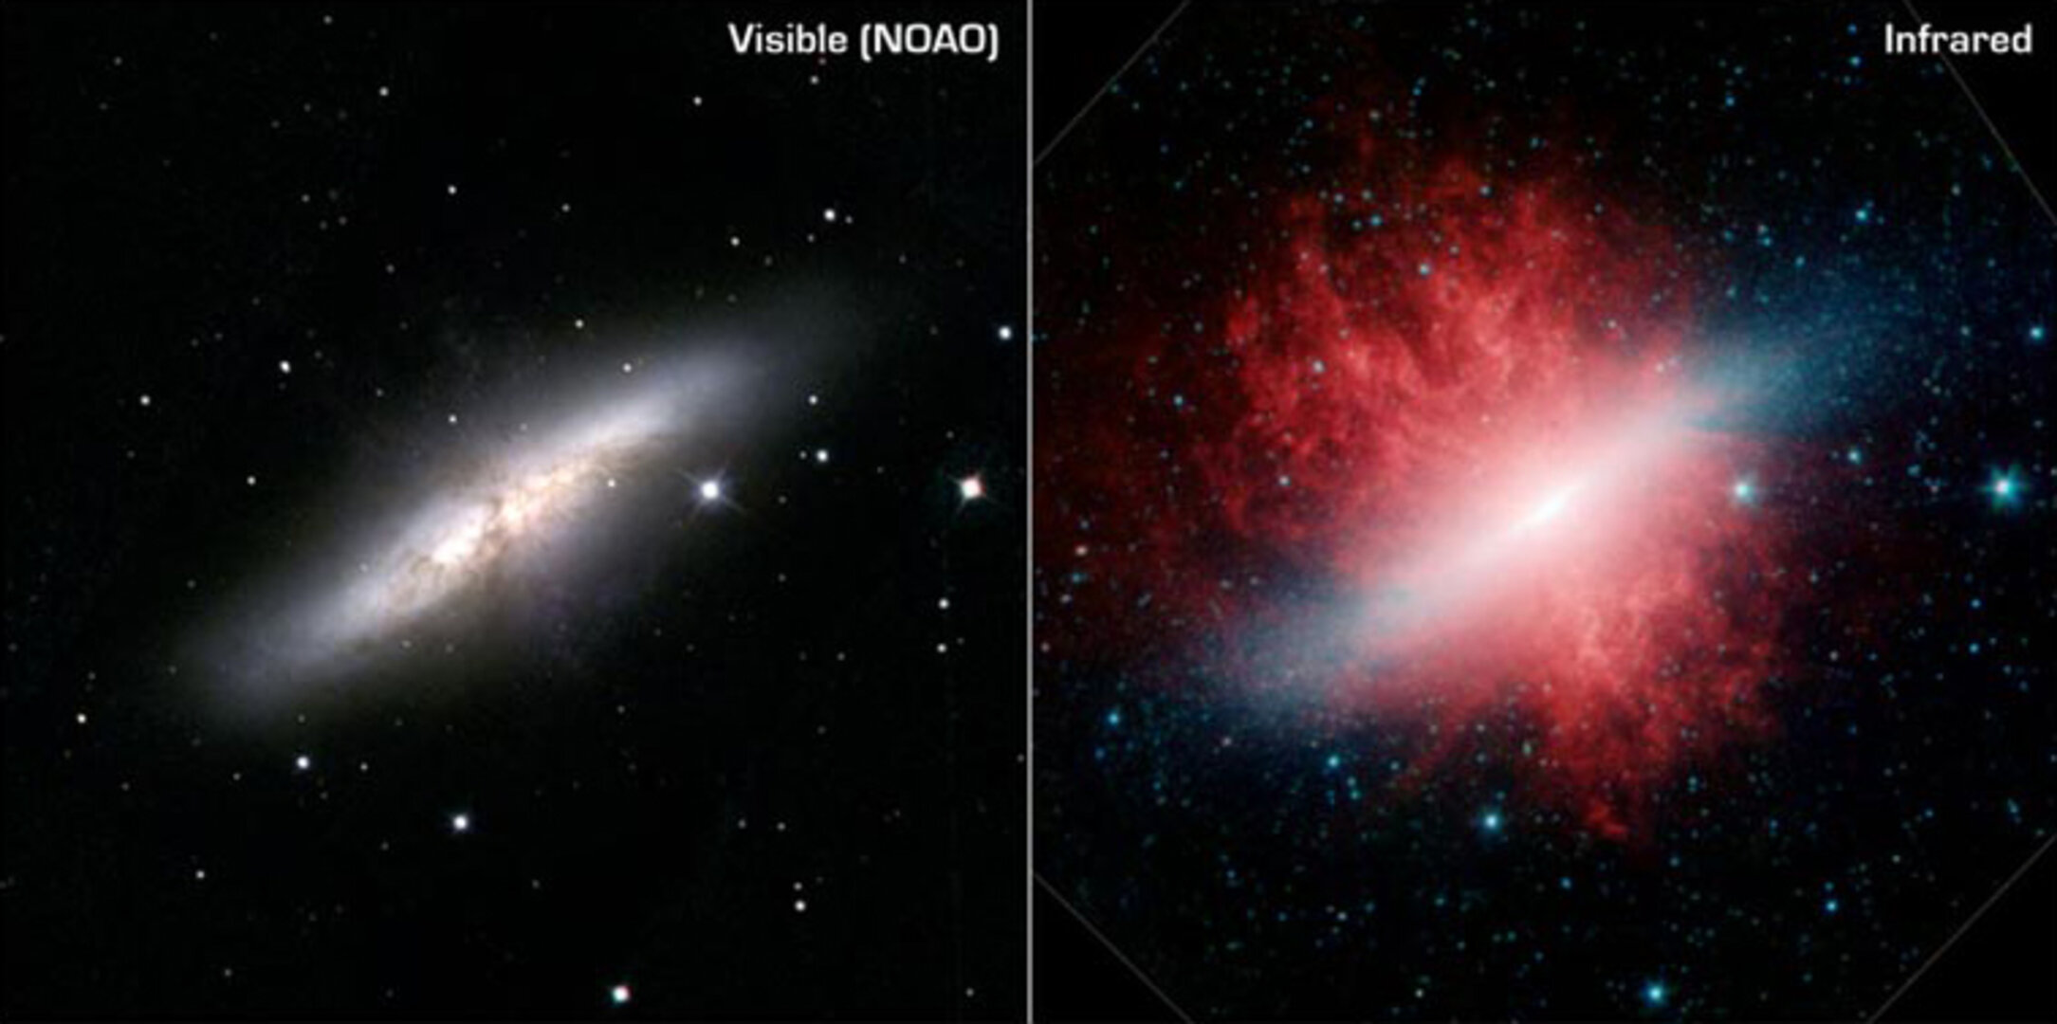

Slide 42
RADIO WAVES
Radio Waves are used for telecommunication (radio, TV etc.). But how do they work?
There are lots of different things to consider when designing broadcast & reception antennae. We will consider only simple antennae.
A broadcast antenna has an alternating current running through it; the changing electric field induces a changing magnetic field which induces a changing electric field… etc.

Slide 43
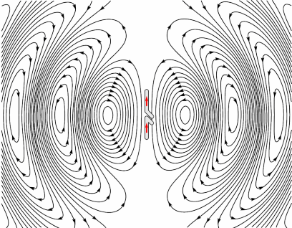

Slide 44
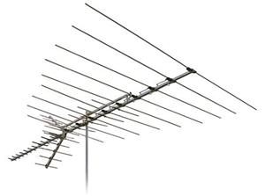
ANTENNAE
The receiving antenna will have a current induced along it when it receives the broadcast signal.
Orientation is important – if transmitter and receiver are oriented differently, induction will be limited and the receiver can’t/won’t receive.
Optimal orientation minimises signal “noise” by optimising reception.
Different lengths of wire are tuned to different frequencies (length from tip-to-tip is a ‘half-wavelength’). Higher frequencies = smaller antennae.

Slide 45
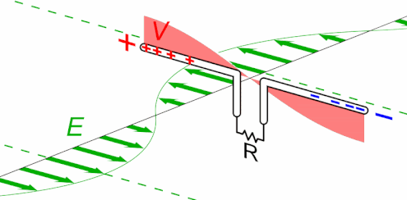

Slide 46
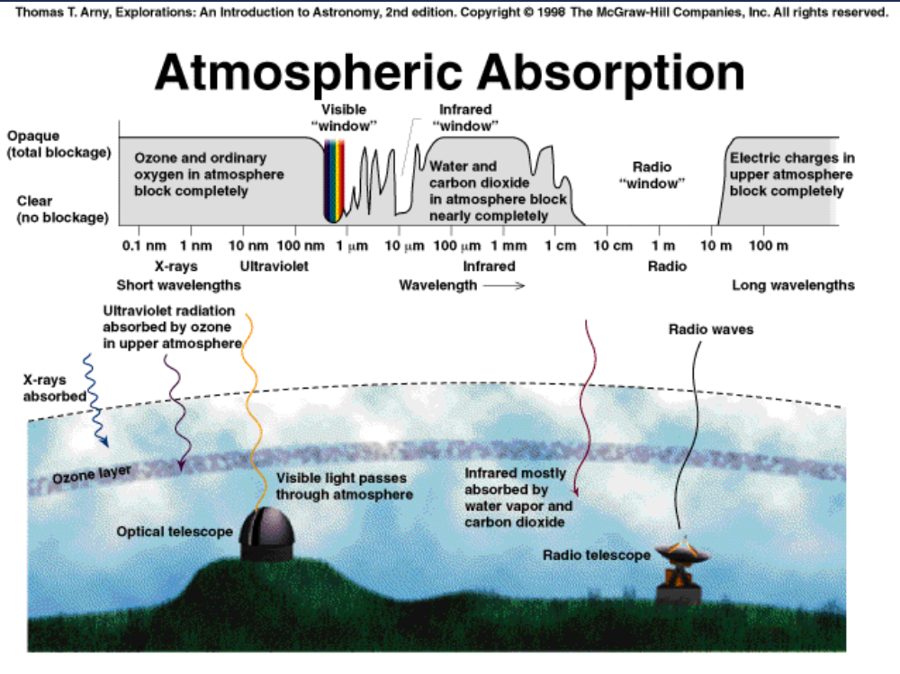

Slide 47
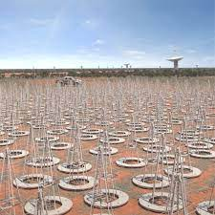
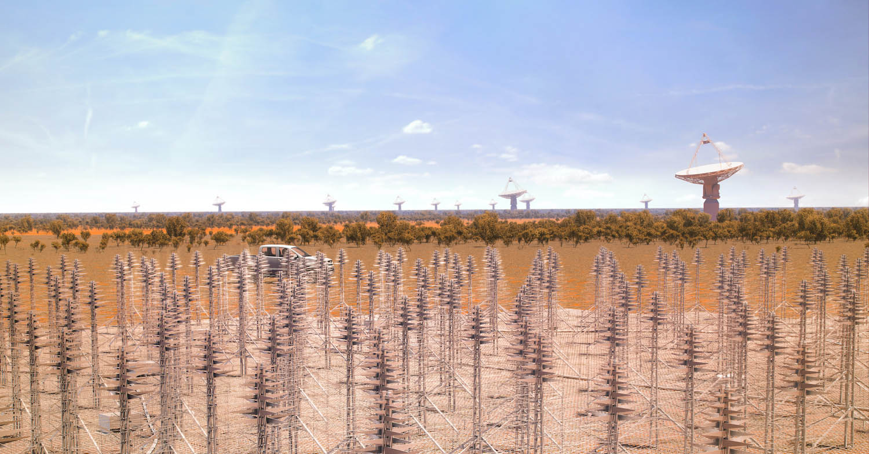

SQUARE KILOMETER ARRAY
&
MURCHISON WIDEFIELD ARRAY

Slide 48
FARADAY CAGE
A Faraday cage or Faraday shield is an enclosure used to block electromagnetic fields. A Faraday shield may be formed by a continuous covering of conductive material, or in the case of a Faraday cage, by a mesh of such materials. Faraday cages are named after the English scientist Michael Faraday, who invented them in 1836.
A Faraday cage operates because an external electrical field causes the electric charges within the cage's conducting material to be distributed so that they cancel the field's effect in the cage's interior. This phenomenon is used to protect sensitive electronic equipment. They are also used to protect people and equipment against actual electric currents such as lightning strikes and electrostatic discharges, since the enclosing cage conducts current around the outside of the enclosed space and none passes through the interior.

Slide 49
FARADAY CAGE
Faraday cages cannot block stable or slowly varying magnetic fields, such as the Earth's magnetic field (a compass will still work inside). To a large degree, though, they shield the interior from external electromagnetic radiation if the conductor is thick enough and any holes are significantly smaller than the wavelength of the radiation.
A common misconception is that a Faraday cage provides full blockage or attenuation; this is not true. The reception or transmission of radio waves, a form of electromagnetic radiation, to or from an antenna within a Faraday cage is heavily attenuated or blocked by the cage; however, a Faraday cage has varied attenuation depending on wave form, frequency or distance from receiver/transmitter, and receiver/transmitter power. Near-field high-powered frequency transmissions like HF RFID are more likely to penetrate. Solid cages generally attenuate fields over a broader range of frequencies than mesh cages.

Slide 50


Slide 51



FARADAY CAGE

Slide 52

FARADAY CAGE

Slide 53
BLACKBODY RADIATION
All objects that have a temperature above absolute zero (-273.15˚C) emit electromagnetic radiation. At room temperature, most of this radiation is in the infrared part of the spectrum (and is thus invisible to the naked eye).
At higher temperatures, the amount of radiation emitted is greater, and the peak-frequency increases (wavelength decreases), meaning that more of the emitted radiation is in the visible spectrum.

Slide 54





BLACKBODY RADIATION

Slide 55

BLACKBODY RADIATION
For an ideal blackbody radiator, the emission spectrum will depend solely upon temperature. In reality, the type and shape of material also play a role.
Why is it called a blackbody radiator? A blackbody is an ideal absorber that absorbs all incident radiation (by contrast, a whitebody would be a perfect reflector, having a high albedo). It is also in thermal equilibrium with its surroundings, so it absorbs and emits/radiates energy at the same rate.

Slide 56
BLACKBODY RADIATION
In the laboratory, blackbody radiation is approximated by the radiation from a small hole in a large cavity in an entirely opaque body that is that is maintained at a constant temperature.
Any light entering the hole would have to reflect off the walls of the cavity multiple times before it escaped, in which process it is nearly certain to be absorbed. Absorption occurs regardless of the wavelength of the radiation entering (as long as it is small compared to the hole).
The hole, then, is a close approximation of a theoretical black body and, if the cavity is heated, the spectrum of the hole's radiation (i.e., the amount of light emitted from the hole at each wavelength) will be continuous, and will depend only on the temperature.
Notes:
Black-body radiation - Wikipedia

Slide 57



BLACKBODY RADIATION

Slide 58

BLACKBODY RADIATION
For an ideal blackbody radiator, there is a mathematical relationship between the peak wavelength emitted and the temperature, called Wien’s Displacement Law:
$$λ_{peak}=\frac{b}{T}$$
    Where ‘b’ is Wien’s Displacement Constant
    (b = 2.897771955 × 10⁻³ m K)
    ‘T’ is temperature in Kelvin (K)

Slide 59
BLACKBODY RADIATION
So, why all this fuss over blackbody radiators? Well, an understanding between emitted wavelength and temperature allows us to approximate the temperature of things that otherwise could not; stars, galaxies, even space itself.

Slide 60

BLACKBODY RADIATION
Notes:
Note: How do we work out the relative mass of stars? Hint: Think back to Gravitation!

Slide 61
BLACKBODY RADIATION
The science of blackbody radiators has been well understood for well over a century. The mathematics of blackbody radiators, however, ran into a slight hiccup around 1900. The problem? It didn’t work!
Well, that’s not strictly true. The law used to predict the intensity & peak wavelength was called the Rayleigh-Jeans Law, and it worked pretty well for long wavelengths (low frequencies). However, for short wavelengths (high frequencies), the prediction varies wildly from reality. This clash between classical theory and reality became known as the Ultraviolet Catastrophe.

Slide 62

BLACKBODY RADIATION

Slide 63

BLACKBODY RADIATION

Slide 64
BLACKBODY RADIATION
Essentially, the theory predicted that almost all objects would spontaneously emit an arbitrarily high amount of energy until it was near absolute zero. Since this does not happen (I mean, just look around!), this is obviously wrong.
Max Planck resolved the issue by assuming that molecules vibrate at discrete frequencies, and that they gain or lose energy by absorbing or emitting radiation in discrete packets called photons (later confirmed by Bose & Einstein).
He even developed an equation to determine the energy of these photons.

Slide 65

PLANCK’S EQUATION

Slide 66

PLANCK’S EQUATION
This ‘quantum’ interpretation worked beautifully in resolving the apparent paradox of the Ultraviolet Catastrophe; however, those little ‘packets’ of light – the photons – were essentially light particles. Up until this point, the wave theory for light was generally accepted (it easily explains just about every property of light); on this occasion, however, the wave model for light was unable to explain the experimental observations being made, but a particle model was successful in doing so. Thus, Quantum Theory was born!

Slide 67
PLANCK’S EQUATION
Example: Find the energy for a UV photon (f = 2.00 x 10¹⁵ Hz):
Answer: E = hf = (6.63 x 10⁻³⁴)(2.00 x 10¹⁵) = 1.33 x 10⁻¹⁸ J.
Because the energies involved are so small, it is common to convert these energies to electron-volts (1 eV = 1.60 x 10⁻¹⁹ J). Therefore:
1.33 x 10⁻¹⁸ J / 1.60 x 10⁻¹⁹ = 8.3125 = 8.31 eV

Slide 68

PLANCK’S EQUATION
Example: A photon has an energy of 1.24 MeV. What part of the spectrum is it from?
Answer: (1.24 x 10⁶)(1.60 x 10⁻¹⁹) = 1.984 x 10⁻¹³ J
f = E/h = 1.984 x 10⁻¹³ / 6.63 x 10⁻³⁴ = 2.99 x 10²⁰ Hz = Gamma Ray/X-Ray

Slide 69

THE PHOTOELECTRIC EFFECT
Another phenomenon that could not be explained via the wave model for light was the Photoelectric Effect.

Slide 70


THE PHOTOELECTRIC EFFECT
Notes:
Demo Fuse wire – heat until orange, red, white, melts OR use Thermit reaction & surface temp thermometer (too hot?)

Slide 71

The Photoelectric Effect
(sort of how a solar panel works)
We need to understand:
Basic nature of the photoelectric effect
Plank’s equation for the energy of a photon (E_{ph} = hf)
Frequency threshold
Work function (Ф)
Stopping voltage (stopping potential)
Equation for an ejected photoelectron: KE_{max} = hf - φ

Slide 72

Experimental setup to show the photoelectric effect

Slide 73

Laws of photoelectric effect
1. Number of photoelectrons is proportional to light intensity

Slide 74

Laws of photoelectric effect
2. Each metal has a different threshold frequency below which no photoelectrons are produced irrespective of light intensity.

Slide 75
Laws of photoelectric effect
3. A range of energies are produced but the maximum value depends on colour (frequency)

Slide 76
Wave theory can’t explain why colour is the most important factor in the photoelectric effect. It predicts that intensity should be the main factor.
?

Slide 77






Slide 78
All balls are 2kg.
4m
8m
10m
1
2
3
Give ball one 50 J what happens?

Slide 79
All balls are 2kg.
4m
8m
10m
1
2
3
Give ball one 80 J what happens?

Slide 80
All balls are 2kg.
4m
8m
10m
1
2
3
Give ball one 100 J what happens?

Slide 81
All balls are 2kg.
4m
8m
10m
1
2
3
Give ball two 100 J what happens?

Slide 82
All balls are 2kg.
4m
8m
10m
1
2
3
Give ball two 200 J what happens?

Slide 83
All balls are 2kg.
4m
8m
10m
1
2
3
Give ball three 100 J what happens?

Slide 84
All balls are 2kg.
4m
8m
10m
1
2
3
Give ball three 200 J what happens?

Slide 85
4m
8m
10m
1
2
3
Summary:
If energy is supplied in ‘packets’, then there is a minimum amount of energy for any ball to escape. Nothing will escape below this threshold.
Remaining energy presents as a range of KE
If the energy supplied just equals threshold energy, then KE = 0

Slide 86
Einstein explained the photoelectric effect by assuming that light is made up of photons each with an energy given by Planck’s equation E_{ph} = hf
(where Planck’s constant is 6.63x10⁻³⁴ J s)

Slide 87
The electrons use some energy to escape from the metal and so escape with a range of kinetic energy

Slide 88
This electron is far below the surface and needs a lot of energy to escape. It emerges with very little KE.
This electron is so far below the surface it can’t get enough energy to escape.
This electron is very close to the surface and so escapes very easily with lots of KE.

Slide 89
This photon has an energy E =hf.
The minimum energy to knock an electron out of the metal – even at the surface of the metal - is called the work function, Φ.
The maximum possible kinetic energy of an ejected photoelectron is the difference between the photon energy and the work function.

Slide 90

Einstein’s Photoelectric equation :
Maximum possible Kinetic energy of ejected electrons (J)
Energy of photon (J)
Work function (J)
Notes:
90

Slide 91

OR:

Slide 92


Slide 93
Threshold frequency f_{min}
Emission of electrons from the surface can only occur if :
≥
≥
=
min
The threshold frequency is the minimum frequency (of the incident radiation) required for an emission of an electron to occur. If the frequency is below this threshold, no electrons are ejected.
KE of the electrons = 0 when the frequency of the incident radiation is f_{min}

Slide 94

KE_{max} versus frequency graph
Threshold frequency

Slide 95
STOPPING VOLTAGE/BIAS
Consider the setup for the Photoelectric Effect (below). Now, consider that the ‘collector’ plate was at a positive potential compared to the ‘emitter’ plate. The electrons would accelerate towards the collector plate when ejected from the emitter plate.
What if the collector plate was at a negative potential instead?

Slide 96
STOPPING VOLTAGE/BIAS
The electrons, when ejected from the emitter, would begin to slow down as they approached the collector plate. If the potential difference was sufficient, then it would be possible to ensure that no electrons reach the collector plate at all. The minimum voltage required to do this is called the stopping voltage.

Slide 97
STOPPING VOLTAGE/BIAS
In order to prevent all electrons from reaching the collector plate, we must do work on the electrons. The work done must be enough to ensure that even the most energetically ejected electrons have insufficient kinetic energy to reach the plate (by making the total energy go to 0).

Slide 98

STOPPING VOLTAGE/BIAS
The work done on a charged particle in an electric field (i.e. passing through a potential difference): W = qV.
Therefore:
$$E_{K(Max)}=q_{e}V_{S}$$
Where q_{e} = electron charge &
V_{S} = Stopping Voltage.
Notes:
Photoelectric Effect - Light | Quantum Mechanics | Photons - PhET Interactive Simulations (colorado.edu) (seems to work now, but load in advance),
or https://applets.kcvs.ca/photoelectricEffect/PhotoElectric.html

Slide 99



Slide 100


Slide 101


SOLAR PANELS
So, how is this relevant to solar panels?
Notes:
N-type silicon has been ‘doped’ and contains ‘holes’ (gaps that can be filled by electrons). When light strikes electrons in p-type silicon, they move to fill these holes. They are now in the ‘conduction band’, allowing them to be drawn into the circuit. Other electrons fill the new ‘holes’ created by these electrons moving (from both bands). As the electrons complete the circuit, they return to the p-type silicon (the ‘valence band’), and wait for sunlight to strike so that the process can be repeated ad nauseam. This process is only ~20% efficient in terms of energy conversion.

Slide 102
Summary
Light comes in packets called photons.
A photon’s energy is given by E = hf
Photons can knock electrons from a metal surface – photoelectron effect
Each metal has a minimum photon energy to for an electron to be ejected (the work function, Ф)
Thus, there is a minimum frequency for an electron to be ejected (threshold frequency)
Photons below the threshold will never eject e⁻s
Photons above the threshold frequency can eject e⁻s, and the extra energy (hf- Ф) will be present as KE in the e⁻s

Slide 103
Questions

Slide 104
1. Calculate the wavelength of light, in nm, illuminating a barium surface if the threshold frequency of barium is 6.07 x 10¹⁴ Hz and the kinetic energy of the electron emitted is 1.31 x 10⁻¹⁸ J.
2. If barium has a threshold frequency of 6.07 x 10¹⁴ Hz, calculate the kinetic energy of the electron emitted when barium is illuminated with a wavelength of 385 nm.

Slide 105
1. Calculate the wavelength of light, in nm, illuminating a barium surface if the threshold frequency of barium is 6.07 x 10¹⁴ Hz and the kinetic energy of the electron emitted is 1.31 x 10⁻¹⁸ J.
Ans. 116 nm
2. If barium has a threshold frequency of 6.07 x 10¹⁴ Hz, calculate the kinetic energy of the electron emitted when barium is illuminated with a wavelength of 385 nm.
Ans. 1.14 x 10⁻¹⁹J.

Slide 106
3. Calculate the threshold wavelength, in nm, of a metal if that metal emits an electron with a kinetic energy of 6.32 x 10⁻¹⁹ J when illuminated with light that has a frequency of 1.97 x 10¹⁵ Hz.
4. Calculate the frequency of light illuminating a copper surface if the threshold frequency of copper is 1.08 x 10¹⁵ Hz and the velocity of the electron emitted is 1.11 x 10⁶ m/s.

Slide 107
3. Calculate the threshold wavelength, in nm, of a metal if that metal emits an electron with a kinetic energy of 6.32 x 10⁻¹⁹ J when illuminated with light that has a frequency of 1.97 x 10¹⁵ Hz.
Ans. 295 nm
4. Calculate the frequency of light illuminating a copper surface if the threshold frequency of copper is 1.08 x 10¹⁵ Hz and the velocity of the electron emitted is 1.11 x 10⁶ m/s.
Ans. 1.92 x 10¹⁵ Hz.

Slide 108
5. An instrument is sensitive to light packets that carry at least 1.03 x 10⁻¹⁶ J of energy. How many photons of light of frequency of 3.02 x 10¹³ Hz can the instrument detect?
6. A laser emits a pulse of light containing 2.46 x 10⁻¹⁶ J of energy at a frequency of 3.25 x10¹⁴ Hz. How many photons are present in the pulse?
7. Calculate the threshold wavelength, in nm, of a metal if that metal emits an electron with a kinetic energy of 2.09 x 10⁻¹⁹ J when illuminated with light that has a frequency of 1.40 x 10¹⁵ Hz.

Slide 109
Extension questions
5. An instrument is sensitive to light packets that carry at least 1.03 x 10⁻¹⁶ J of energy. How many photons of light of frequency of 3.02 x 10¹³ Hz can the instrument detect?
6. A laser emits a pulse of light containing 2.46 x 10⁻¹⁶ J of energy at a frequency of 3.25 x10¹⁴ Hz. How many photons are present in the pulse?
7. Calculate the threshold wavelength, in nm, of a metal if that metal emits an electron with a kinetic energy of 2.09 x 10⁻¹⁹ J when illuminated with light that has a frequency of 1.40 x 10¹⁵ Hz.
Ans. 5144 photons.
Ans. 5160 photons.
Ans: 1140
Ans. 278 nm

Slide 110


Slide 111


Slide 112


Slide 115


Slide 116


Slide 117


